Slide 1
CMP202 Assessment
By Fraser Barker(1600196)

Slide 2
Topic
Interactive Mandelbrot
Parallelised using GPU
Lab exercise used as a basis
External Libraries
OpenGL (Year 2, Semester 1 base project file)

Slide 3
Purpose
Interactive Mandelbrot via OpenGL
Demonstrate good GPU parallelisable algorithm.

Slide 4
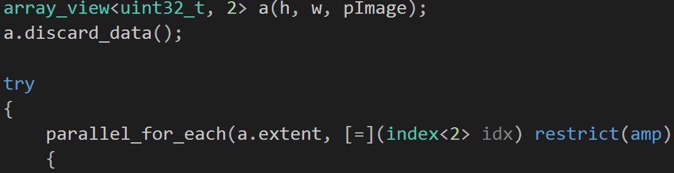
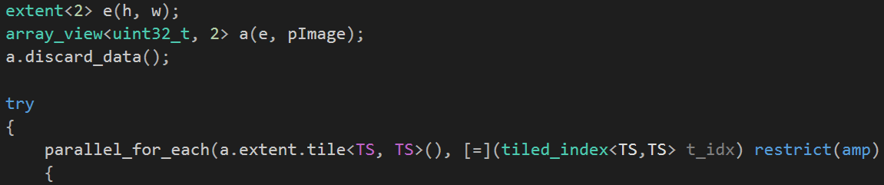
Parallel construction
Pipeline pattern
Single CPU Thread (Host)
SIMD (Device)
OpenGL calls (Kernel)
Mutexes?

Slide 5
Thread utilisation
Single CPU Thread (Host)
Non-tiled GPU kernel vs Tiled GPU kernel
Mandelbrot – Data independent
Multi GPU (future)

Slide 6
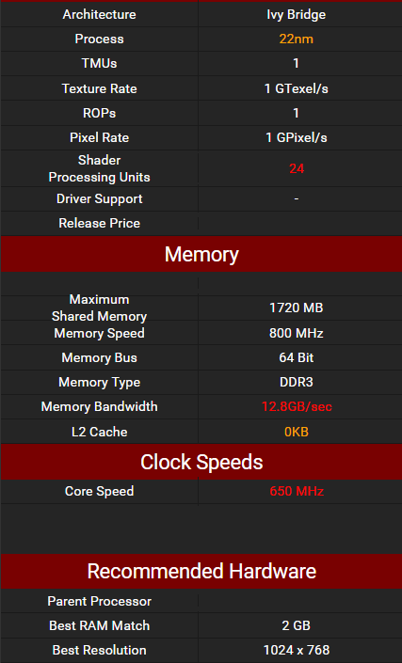
Specification
4506 Lab Computers
OS – Windows 7 Professional
GPU – Intel® HD Graphics 2500
CPU – Intel® Core™ i5-3470S @ 2.90GHz
RAM – 4GB

Slide 7
Results
Time taken to compute Mandelbrot at various levels. (Iterations, Width/Height) (ms)
1000 x (500,2500,5000 Max_Iters) @ 640x480
1000 x (500,2500,5000 Max_Iters) @ 960x768
1000 x (500,2500,5000 Max_Iters) @ 1280x960
1000 x (500,2500,5000 Max_Iters) @ 1920x1280
Eliminate sources of error

Slide 8
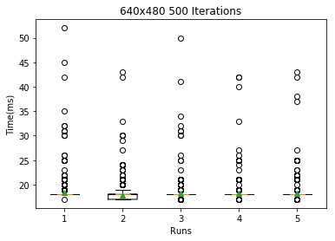
Results – 640x480 – 500 Iterations
Data1 - Mean: 18.4105894106
Data1 - Median: 18.0
Data2 - Mean: 17.8291708292
Data2 - Median: 18.0
Data3 - Mean: 18.1508491508
Data3 - Median: 18.0
Data4 - Mean: 18.2137862138
Data4 - Median: 18.0
Data5 - Mean: 18.2157842158
Data5 - Median: 18.0

Slide 9
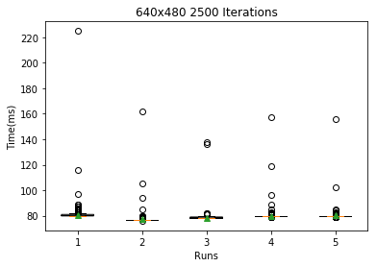
Results – 640x480 – 2500 ITERATIONS
Data1 - Mean: 80.6573426573
Data1 - Median: 80.0
Data2 - Mean: 77.2767232767
Data2 - Median: 77.0
Data3 - Mean: 78.4095904096
Data3 - Median: 78.0
Data4 - Mean: 80.0799200799
Data4 - Median: 80.0
Data5 - Mean: 80.1378621379
Data5 - Median: 80.0

Slide 10
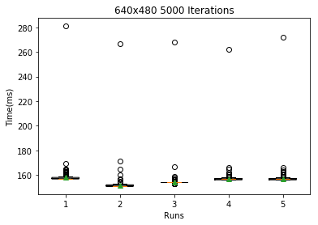
Results – 640x480 – 5000 ITERATIONS
Data1 - Mean: 157.963036963
Data1 - Median: 157.0
Data2 - Mean: 151.51048951
Data2 - Median: 151.0
Data3 - Mean: 154.268731269
Data3 - Median: 154.0
Data4 - Mean: 156.754245754
Data4 - Median: 157.0
Data5 - Mean: 156.92007992
Data5 - Median: 157.0

Slide 11
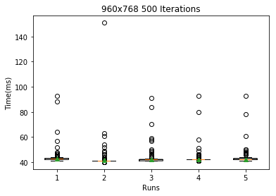
Results – 960x768 – 500 ITERATIONS
Data1 - Mean: 42.6983016983
Data1 - Median: 43.0
Data2 - Mean: 41.4445554446
Data2 - Median: 41.0
Data3 - Mean: 41.9380619381
Data3 - Median: 42.0
Data4 - Mean: 42.2747252747
Data4 - Median: 42.0
Data5 - Mean: 42.4185814186
Data5 - Median: 42.0

Slide 12
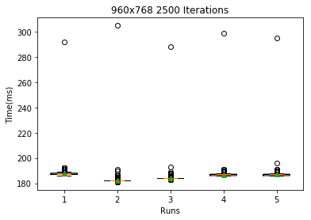
Results – 960x768 – 2500 ITERATIONS
Data1 - Mean: 187.566433566
Data1 - Median: 187.0
Data2 - Mean: 182.123876124
Data2 - Median: 182.0
Data3 - Mean: 184.236763237
Data3 - Median: 184.0
Data4 - Mean: 186.776223776
Data4 - Median: 187.0
Data5 - Mean: 186.97002997
Data5 - Median: 187.0

Slide 13
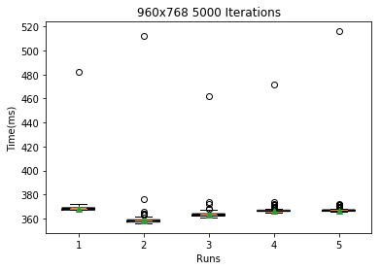
Results – 960x768 – 5000 ITERATIONS
Data1 - Mean: 368.331668332
Data1 - Median: 368.0
Data2 - Mean: 358.282717283
Data2 - Median: 358.0
Data3 - Mean: 362.982017982
Data3 - Median: 363.0
Data4 - Mean: 366.833166833
Data4 - Median: 366.0
Data5 - Mean: 366.839160839
Data5 - Median: 367.0

Slide 14
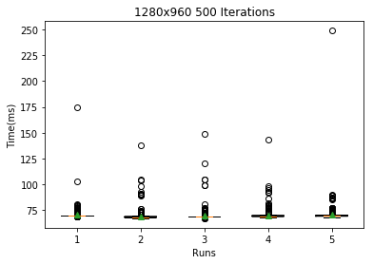
Results – 1280x960 – 500 ITERATIONS
Data1 - Mean: 70.2417582418
Data1 - Median: 70.0
Data2 - Mean: 68.8521478521
Data2 - Median: 68.0
Data3 - Mean: 69.4185814186
Data3 - Median: 69.0
Data4 - Mean: 69.8181818182
Data4 - Median: 69.0
Data5 - Mean: 70.2057942058
Data5 - Median: 70.0

Slide 15
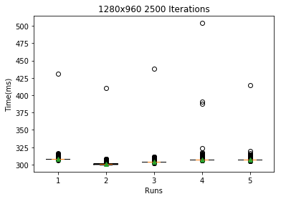
Results – 1280x960 – 2500 ITERATIONS
Data1 - Mean: 308.418581419
Data1 - Median: 308.0
Data2 - Mean: 301.057942058
Data2 - Median: 301.0
Data3 - Mean: 304.186813187
Data3 - Median: 304.0
Data4 - Mean: 307.411588412
Data4 - Median: 307.0
Data5 - Mean: 307.253746254
Data5 - Median: 307.0

Slide 16
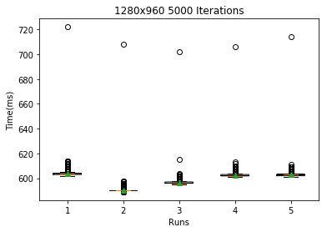
Results – 1280x960 – 5000 ITERATIONS
Data1 - Mean: 603.978021978
Data1 - Median: 604.0
Data2 - Mean: 590.294705295
Data2 - Median: 590.0
Data3 - Mean: 596.665334665
Data3 - Median: 596.0
Data4 - Mean: 602.69030969
Data4 - Median: 602.0
Data5 - Mean: 602.886113886
Data5 - Median: 603.0

Slide 17
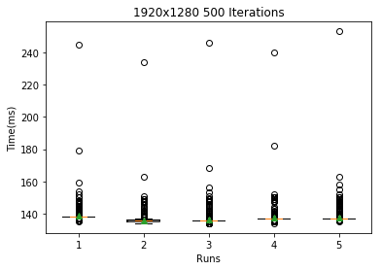
Results – 1920x1280 – 500 ITERATIONS
Data1 - Mean: 138.552447552
Data1 - Median: 138.0
Data2 - Mean: 136.03996004
Data2 - Median: 136.0
Data3 - Mean: 136.529470529
Data3 - Median: 136.0
Data4 - Mean: 137.585414585
Data4 - Median: 137.0
Data5 - Mean: 137.517482517
Data5 - Median: 137.0

Slide 18
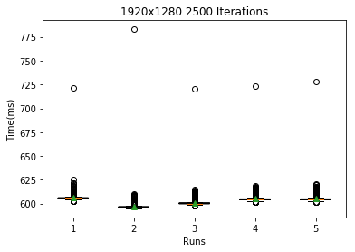
Results – 1920x1280 – 2500 ITERATIONS
Data1 - Mean: 606.14985015
Data1 - Median: 606.0
Data2 - Mean: 596.944055944
Data2 - Median: 596.0
Data3 - Mean: 600.948051948
Data3 - Median: 600.0
Data4 - Mean: 605.020979021
Data4 - Median: 604.0
Data5 - Mean: 604.929070929
Data5 - Median: 604.0

Slide 19
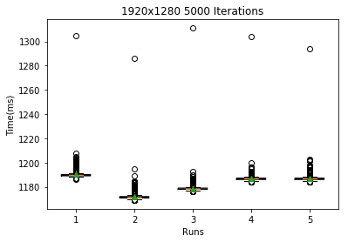
Results – 1920x1280 – 5000 ITERATIONS
Data1 - Mean: 1190.27072927
Data1 - Median: 1190.0
Data2 - Mean: 1171.91808192
Data2 - Median: 1171.0
Data3 - Mean: 1178.58941059
Data3 - Median: 1178.0
Data4 - Mean: 1187.05394605
Data4 - Median: 1187.0
Data5 - Mean: 1187.07992008
Data5 - Median: 1187.0

Slide 20
Explanation
An explanation of these results in terms of the design of your application and your understanding of processor and memory architecture (i.e a description of why it performs the way it does) on the CPU or GPU.

Slide 21
Key results
Presentation of key results of the performance evaluation (Slides 3 – 5)
Timing against various renderings of Mandelbrot.

Slide 22
Critical evaluation
A critical evaluation of the effectiveness of your solution, with reference to your performance evaluation.

Slide 23
Technical choices
You must explicitly justify your technical choices, and quantify their effect during performance evaluation, using the knowledge you’ve gained from undertaking the module.

Slide 24
Resources
SciPy – Statistics calculations, graphical representations.
Adam Sampson/Ruth Falconer – Lab project which this submission is based off of.
Paul Robertson – OpenGL base project

